Slide 1



Problem Statement and Context
Postgraduate Diploma in
Development Finance – Research Orientation
Dr Pieter Opperman

Slide 2
Purpose of Research
Exploration
To satisfy the researcher’s curiosity and desire for better understanding
To test the feasibility of undertaking a more extensive study
To develop the methods to be employed in any subsequent study
Description
Describe situations and events through scientific observation
Descriptive studies answer questions of what, where, when, and how
Explanation
Explanatory studies answer questions of why
Goal: to find a few factors that can account for many of the variations in a given phenomenon

Slide 3
THE PROBLEM STATEMENT (WHAT MAKES THE STUDY WORTHWHILE?)
A well-defined study begins with a clearly defined purpose
“The formulation of a problem is often more essential than its solution”- Albert Einstein
The problem is rarely clear-cut
Conundrums?
Theoretical (is it inconclusive?)
Empirical (issues with previous methods applied?)
Policy issues?
Lack of empirical studies?
Within which context/background?
Refer to Samples 1 – 3 on LH for discussion in class

Slide 4
RESEARCH QUESTIONS
Research questions will help with:
Your literature search;
Your strategy and tactics for your data gathering;
Your strategy and tactics for analysing the data;
Your writing up of the findings;
Keeping one focussed.
Research questions rephrase research issues into a form that is researchable.

Slide 5
CONVERTING RESEARCH QUESTIONS TO RESEARCH OBJECTIVES
Research Questions | Research Objectives
When has SMME training been effective? | To describe the situations and criteria when SMME training has been effective.
What are the determinants of remittances in West Africa? | To examine the determinants of remittances in West Africa.
Is there a difference in efficiency between large, medium and small saving and credit cooperatives in Tanzania? | To compare efficiency scores between large, medium and small saving and credit cooperatives in Tanzania.
Is there a relationship between foreign bank presence and banking sector development in East Africa? | To investigate the relationship between foreign bank presence and banking sector development in East Africa.
Is there a link between FDI and environmental sustainability in Nigeria? | To investigate if there is a link between FDI and environmental sustainability in Nigeria.

Slide 6
CONVERTING RESEARCH QUESTIONS TO RESEARCH OBJECTIVES
What are the determinants of private capital flow volatility in sub-Saharan Africa?
Is there a relationship between remittance volatility and financial sector development in sub-Saharan Africa?
Is there a relationship between cross-border banking volatility and economic growth in sub-Saharan Africa?
Is there a relationship between financial openness and output volatility in sub-Saharan Africa?
Investigate the determinants of private capital flow volatility in sub-Saharan Africa.
Determine if there is a relationship between remittance volatility and financial sector development in sub-Saharan Africa.
Determine if there is a relationship between cross-border banking volatility and economic growth in sub-Saharan Africa.
Determine if there is a relationship between financial openness and output volatility in sub-Saharan Africa.

Slide 7
YOUR TURN
Take a couple of minutes to read
Abor, et al., 2008. How Does Foreign Direct Investment Affect the Export Decisions of Firms in Ghana?
Ajilore, T. & Ikhide, S. 2012. A bounds testing analysis of migrants remittances and financial development in selected Sub-Saharan African countries.
Bradshaw, T.K. 2002. The contribution of small business loan guarantees to economic development.
TASK:
Identify the problem formulation/statement in each paper

Slide 8
Identify the problem….. Abor et al (2008) How Does Foreign Direct Investment Affect the Export Decisions of Firms in Ghana?
“In fact, there is a widely shared view that FDI promotes exports of host countries by augmenting domestic capital for exports, helping transfer in technology and new products for exports, facilitating access to new and large foreign markets, …”
“Prior studies examining the impact of FDI on export activities of foreign affiliates have typically focused on developed economies (see O’Sullivan,1993; Blake and Pain, 1994; Cabral, 1995; Barry and Bradley, 1997; Greenaway et al., 2001). We are yet to understand the role of FDI in the export behavior of firms in developing countries. “
“Though Wolf (2007) recently examined the determinants of exports using a survey sample of 97 enterprises over a three-year period, she found mixed evidence. Possible problems could be the relatively small sample size and the short time series of her dataset. In this current study, we use a bigger sample with a longer time series. Specifically, the study relies on the Regional Project on Enterprise Development (RPED) dataset. The dataset has about 312 firms covering the period 1991 to 2002.”
“In Ghana, a number of policy initiatives have been made in an attempt to promote FDI and export activities.”

Slide 9
Identify the problem….. Ajilore & Ikhide (2012) A bounds testing analysis of migrants remittances and financial development in …
“One, the devastating effects of the recent global financial crisis have made factors that affect the…”
“Second, existing theoretical and empirical literature on remittances and financial development still presents open and unresolved questions…”
“Third, not only that…, the available few are mostly focused are mostly focused on other developing economies of…”
“…, existing studies on the remittances-financial development nexus have not made sufficient use of the approach.”

Slide 10
Identify the problem….. Bradshaw (2002) The Contribution of Small Business Loan Guarantees to Economic Development
“State programs that help small businesses access credit are important economic development tools (Bates, 1984; Bingham, Hill,&White, 1990; Bradshaw, 1998; Bradshaw&Blakely, 1999; Dewar, 1992; Howland&Miller, 1990; Matz&Ledebur, 1986).
Increased and timely access to capital was the most consistent and pronounced of the recommendations of at least 12 state and regional economic development studies in California….. (Koehler & Moller, 1998).
However, explicit evaluations of public programs that aim to increase small business access to credit are sporadic and inadequate, typically using limited evaluation methodologies (Bartik, 1990, 1994; Dewar & Hagenlocker, 1996; Giloth, 1992). “

Slide 11
Question(s)/Objective(s) must be clear
Back to the 3 papers under discussion
“The main questions raised in this study are: how does FDI affect the export decisions of firms? How does FDI affect export performance of firms? “
“This current study specifically sets out to investigate the export-decision and export performance within the Ghanaian manufacturing sector on a panel of plants from 1992 to 2000.”
“Thus, the objective of this paper is to investigate, the short and long run impact of remittances on financial development in five selected …”
“The purpose of this study is to assess public benefit in terms of jobs and economic activity directly attributable to small business loan guarantees made by the California State Loan Guarantee Program (SLGP), which has been operating since 1968.”

Slide 12
CONTEXT
What was the context in these studies?
Abor et al., (2008)
Ajilore & Ikhide (2012)
Bradshaw (2002)

Slide 13
Unit of Analysis
This must be clear
Individuals versus Aggregates
Individuals
Most common unit of analysis for social research
Students, voters, parents, children, Catholics
Groups
Gang members, families, married couples, friendship groups
Organizations
Corporations, social organizations, colleges
Social Interactions
Telephone calls, dances, online chat rooms, fights
Social Artifacts
Social Artifact – any product of social beings or their behavior.

Slide 14
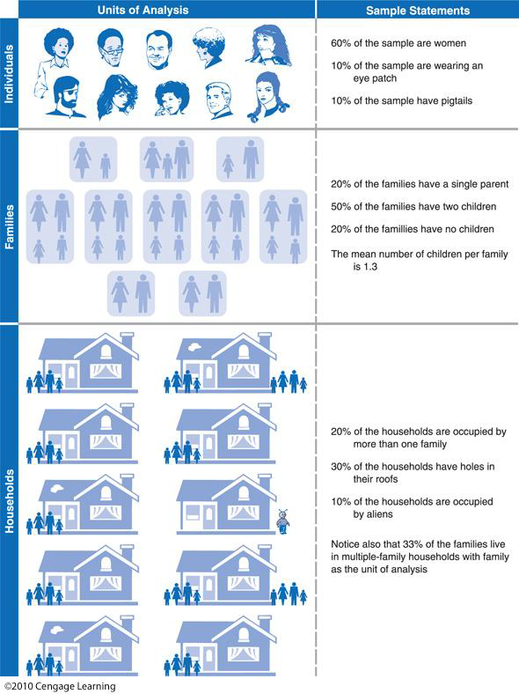

Slide 15
The Time Dimension
Cross-Sectional Study – a study based on observations representing a single point in time, a cross section of a population.
Time Series/Trend Study-a study in which a given characteristic of some population/firm/country (i.e. one unit of cross section) is monitored over time.
Panel Study – a study in which data are collected from the same cross sectional unit at several points in time.

Slide 16
TIME DIMENSION – CROSS SECTIONAL DATA SET ON WAGES AND OTHER INDIVIDUAL CHARACTERISTICS
obsno | wage | educ | exper | female | married
1 | 3.10 | 11 | 2 | 1 | 0
2 | 3.24 | 12 | 22 | 1 | 1
3 | 3.00 | 11 | 2 | 0 | 0
4 | 6.00 | 8 | 44 | 0 | 1
5 | 5.30 | 12 | 7 | 0 | 1
… | … | … | … | … | …
525 | 11.56 | 16 | 5 | 0 | 1
526 | 3.50 | 14 | 5 | 1 | 0
Wooldridge (2009)

Slide 17
TIME DIMENSION – TIME SERIES DATA FOR MINIMUM WAGE, UNEMPLOYMENT, AND RELATED DATA FOR PUERTO RICO
obsno | year | avgmin | avgcov | unemp | gnp
1 | 1950 | 0.20 | 20.1 | 15.4 | 878.7
2 | 1951 | 0.21 | 20.7 | 16.0 | 925.0
3 | 1952 | 0.23 | 22.6 | 14.8 | 1015.9
… | … | … | … | … | …
37 | 1986 | 3.35 | 58.1 | 18.9 | 4281.6
38 | 1987 | 3.35 | 58.2 | 16.8 | 4496.7
Wooldridge (2009:9)

Slide 18
TIME DIMENSION – A TWO-YEAR PANEL DATA SET ON CITY CRIME STATISTICS
obsno | city | year | mur-ders | popula-tion | unem | police
1 | 1 | 1986 | 5 | 350000 | 8.7 | 440
2 | 1 | 1990 | 8 | 359200 | 7.2 | 471
3 | 2 | 1986 | 2 | 64300 | 5.4 | 75
4 | 2 | 1990 | 1 | 65100 | 5.5 | 75
… | … | … | … | … | … | …
297 | 149 | 1986 | 10 | 260700 | 9.6 | 286
298 | 149 | 1990 | 6 | 245000 | 9.8 | 334
299 | 150 | 1986 | 25 | 543000 | 4.3 | 520
300 | 150 | 1990 | 32 | 546200 | 5.2 | 493
Wooldridge (2009:11)

Slide 19
WHERE TO FIND A TOPIC
Workplace
Previous research
Experts and other knowledgeable people
The media?
Exploring list of references and bibliographies

